Slide 1
Phishing Awareness Training
OWOEYE TOLUWALOPE COMFORT

Slide 2
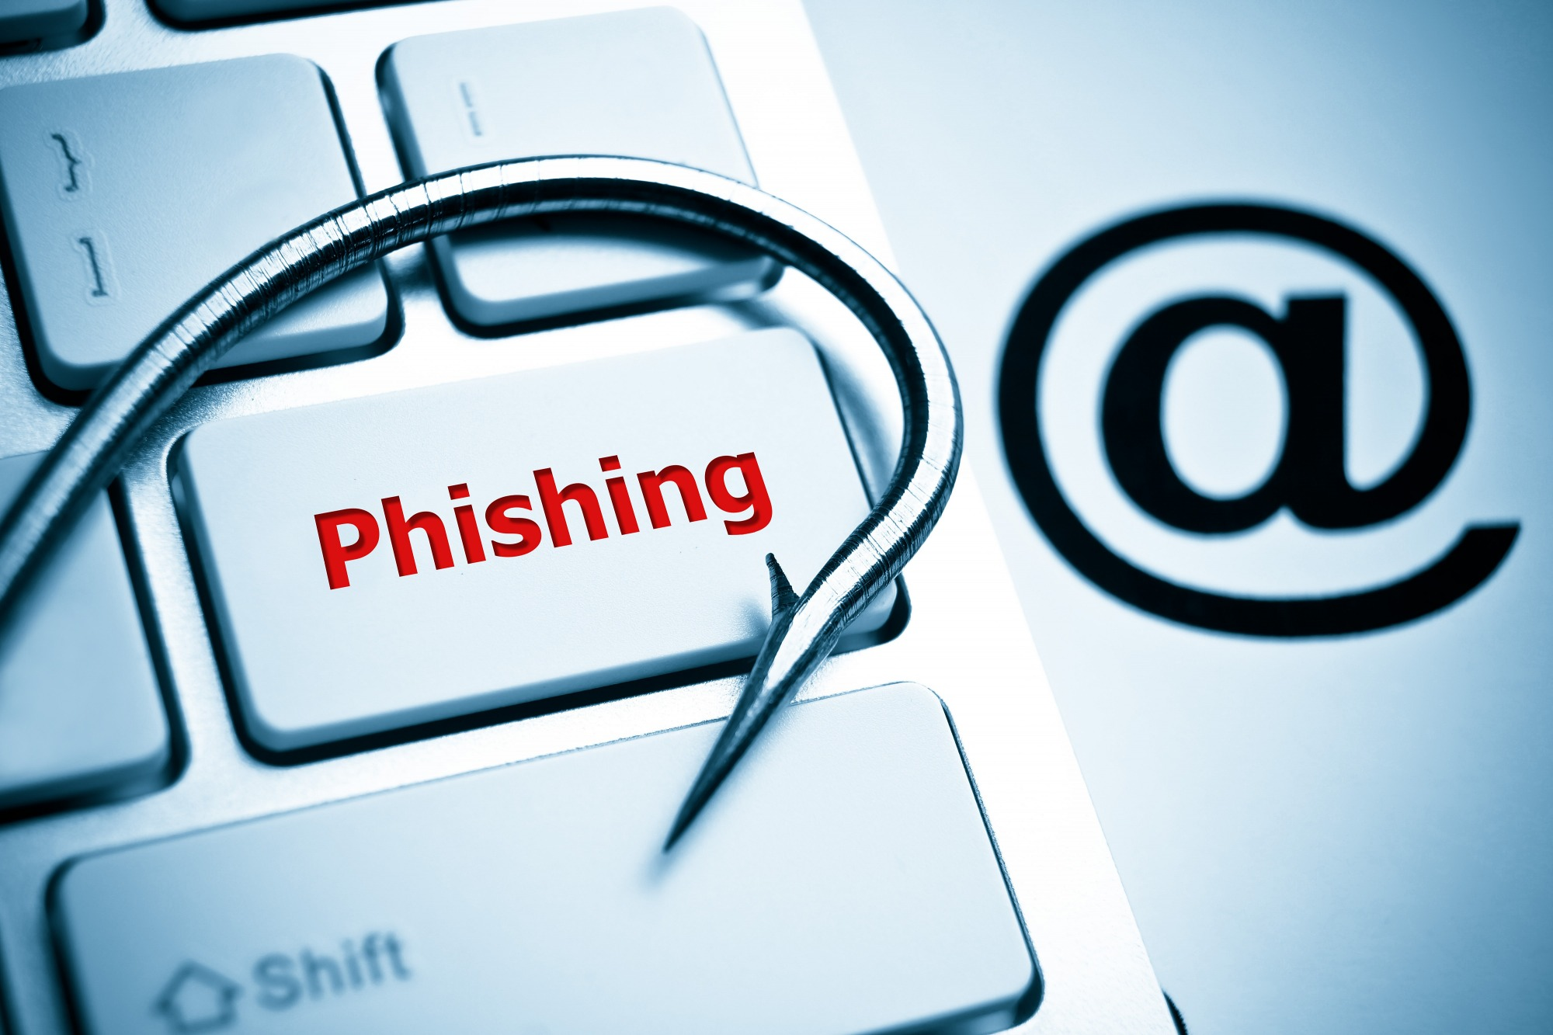
What Is Phishing?
Phishing is the practice of sending fraudulent communications that appear to come from a legitimate and reputable source, usually through email and text messaging. The attacker's goal is to steal money, gain access to sensitive data and login information, or to install malware on the victim's device. Phishing is a dangerous, damaging, and an increasingly common type of cyber-attack.

Slide 3
How does phishing work?
Phishing works by luring a victim with legitimate-looking (but fraudulent) emails or other communication from a trusted (or sometimes seemingly desperate) sender who coaxes victims into providing confidential information—often on what looks to be a convincingly legitimate website.
Sometimes malware or ransom ware is also downloaded onto the victim's computer.
Phishers frequently use tactics like fear, curiosity, a sense of urgency, and greed to compel recipients to open attachments or click on links.
Phishing attacks are designed to appear to come from legitimate companies and individuals.
Cybercriminals are continuously innovating and using increasingly sophisticated techniques, including spear phishing (an attack directed at a specific person or group) and other strategies, to trick users into clicking or tapping.
It only takes one successful phishing attack to compromise your network and steal your data, which is why it is always important to think before you click.

Slide 4
Who are the targets of phishing?
Anyone. Most phishing attacks target numerous email addresses with the hope that some percentage of users will be tricked.

Slide 5
Personal phishing risks include:
Money stolen from your bank account.
Fraudulent charges on credit cards.
Lost access to photos, videos, and files.
Fake social media posts made in your accounts.
Cybercriminals impersonating you, putting friends or family members at risk.
At work, phishing risks include:
Loss of corporate funds.
Exposing personal information of partners, coworkers, and customers.
Files becoming locked and inaccessible.
Damage to your organization's reputation.

Slide 6
Phishing Safety Steps:
Don't click email links from unknown sources.
Monitor your online accounts regularly.
Never give out personal information over email.
Be wary of social, emotion lures.
Take our phishing quiz as part of your phishing education.
Keep your browser updated.
Be aware of popup windows.
Be aware of text messages and phone calls from unknown persons.
Deploy malicious URL detection and content filtering.
Track the latest phishing attacks with advanced phishing protection.

Slide 7
Most common types of phishing attacks
1.Email account compromise - This is a common type of Business email compromise scam in which an employee's email account is hacked and used to request payments from vendors. The money is then sent to attacker-controlled bank accounts.
2.Employee impersonation - This type of Business email compromise takes the form of an email scam, in which a bad actor impersonates a trusted internal employee or vendor to steal money or sensitive information through email.
3.External payment fraud - An email attack is sent to an unsuspecting victim impersonating trusted vendors for invoice payment requests. It is also known as Vendor Email Compromise (VEC).
4.Internal payment fraud - Using stolen credentials an attacker can gain access to internal payment systems such as payment platforms and set up fraudulent vendors, change payment recipients, or redirect payments to their accounts.
5.Payroll diversion fraud - Using stolen email credentials, an attacker emails an organization's payroll or finance department requesting a change to direct-deposit information.

Slide 8
Most common types of phishing attacks Continuous
6.Credential phishing - A bad actor steals login credentials by posing as a legitimate entity using emails and fake login pages. The bad actor then uses the victim's stolen credentials to carry out a secondary attack or extract data.
7.Account takeover - The methods used by attackers to gain access to cloud email, such as a Microsoft 365 email account, are fairly simple and increasingly common.
8.Voice phishing - It is a fraudulent phone call or voice message designed to obtain sensitive information such as login credentials.
9.SMS phishing - Text message, or SMS phishing, can come through random broadcast text messages or portray a known coworker in your organization.
10. Whaling - When attackers go after a "big fish" like a CEO, it's called whaling. These attackers often spend considerable time profiling the target to find the opportune moment and means to steal login credentials.

Slide 9
What should you do as an employee if you suspect a phishing attack?
Report it so the organization can investigate.
What are the most common signs of a phishing scams?
Unknown sender, sense of urgency, unexpected attachment, or too good to be true.
What can happen if you click on a phishing email link or attachment?
The email sender could gain access to company systems.
The email sender could steal your personal information or company information.
The email sender could distribute malware into the company network.
Unsure whether an email is real or phishing? Which of the following should you do?
An unknown email sender sound vague or generic, and is threatening something about one of your online accounts? Report it as phishing.

Slide 10
THANK YOU!!!

